Slide 1


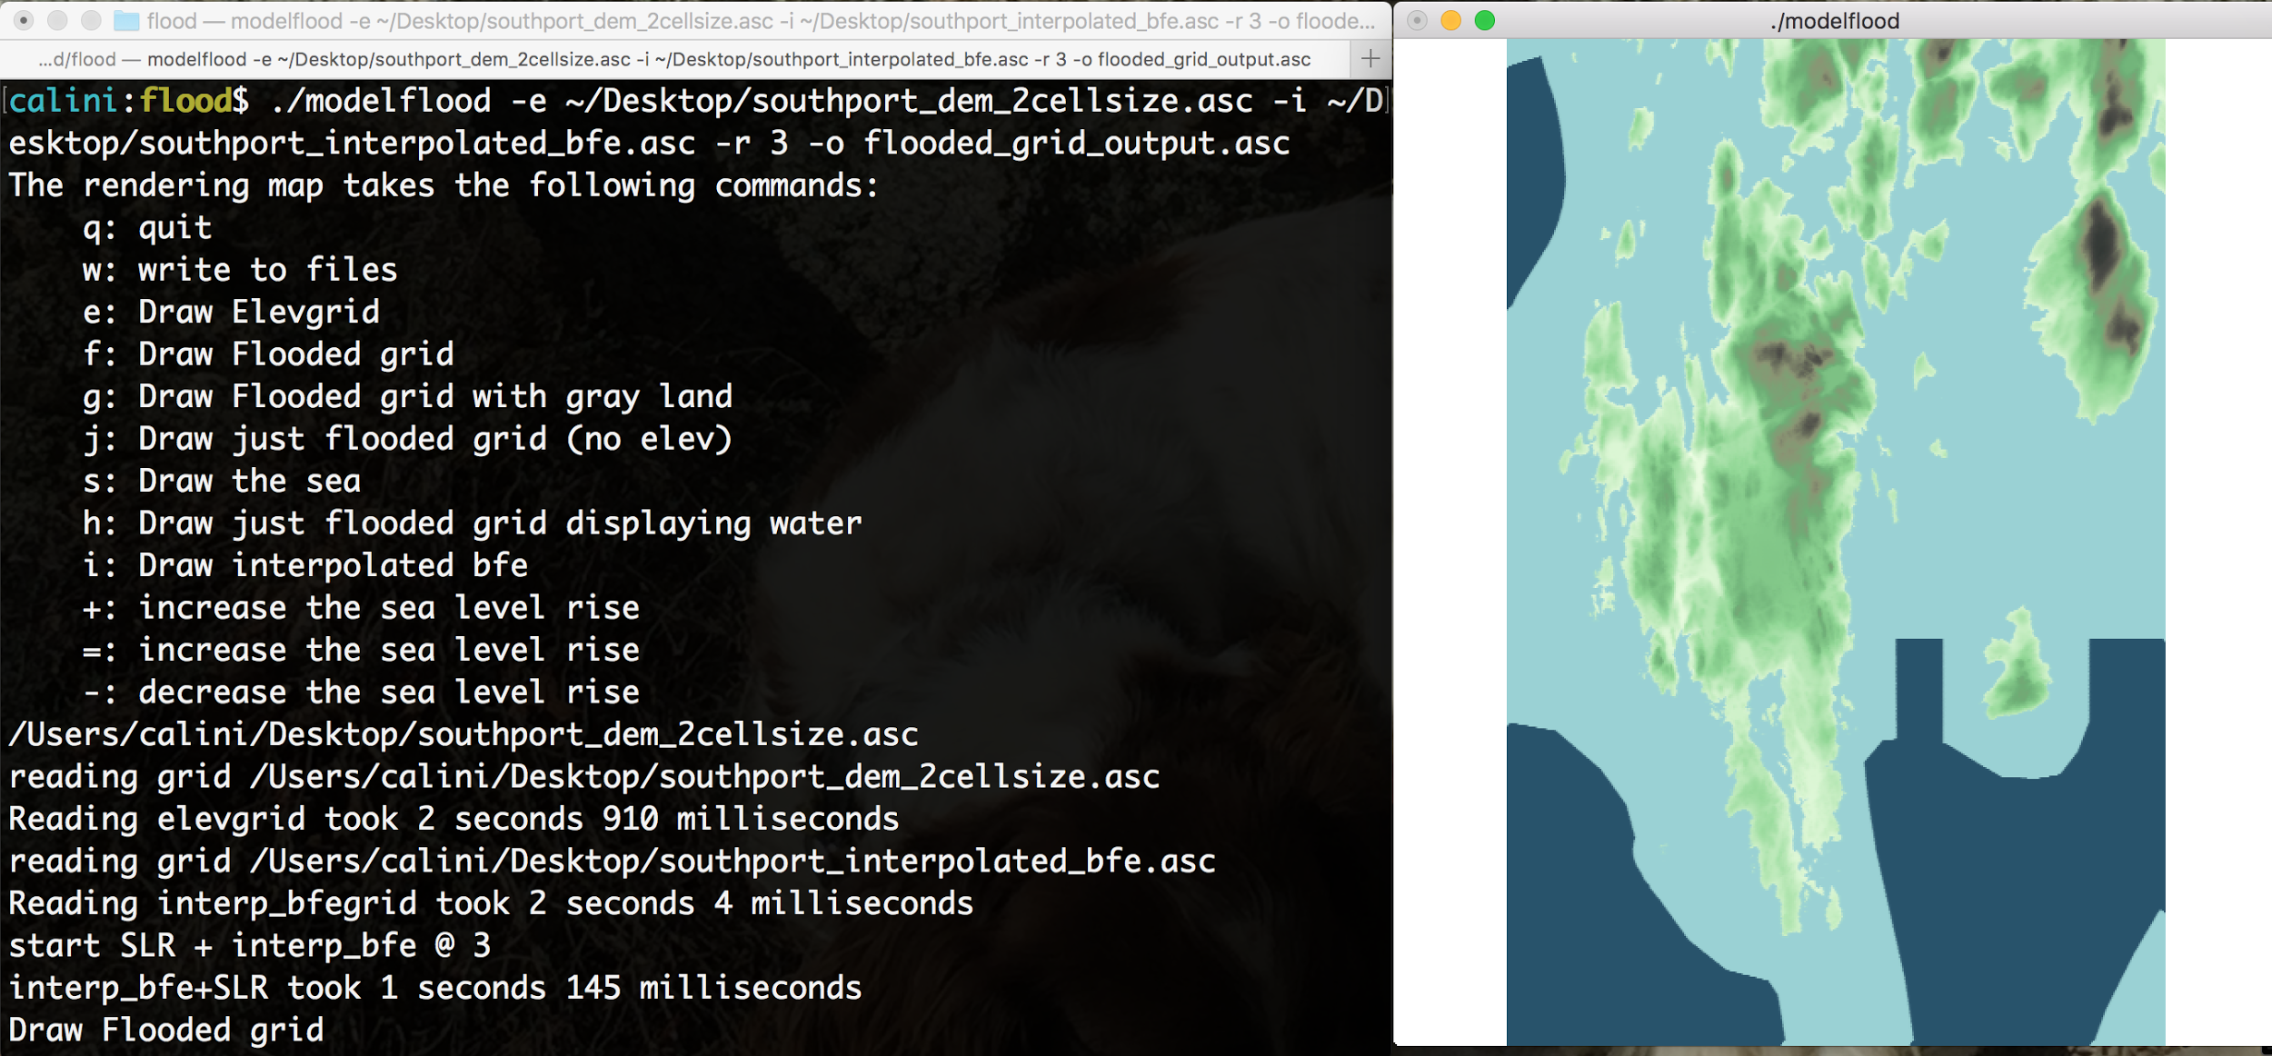
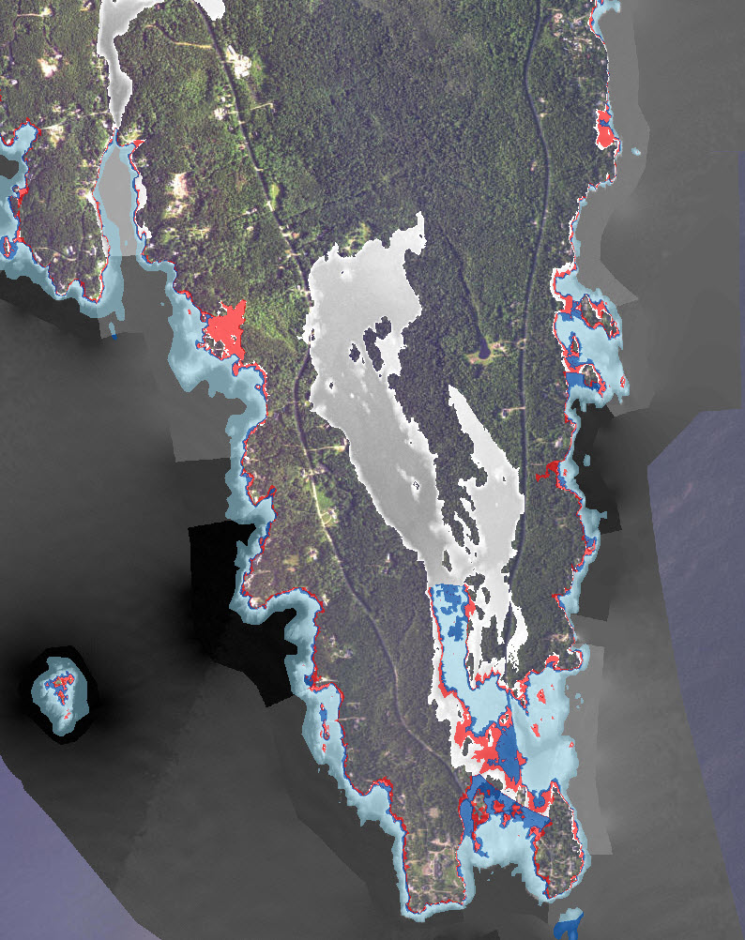
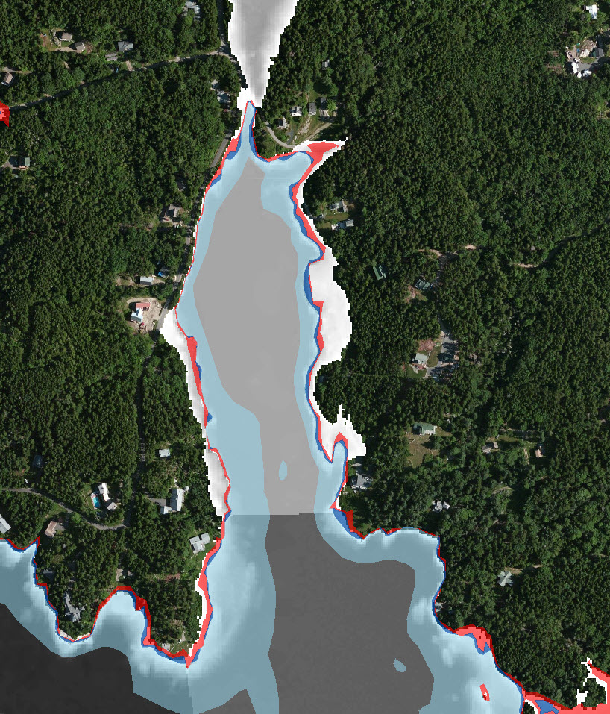
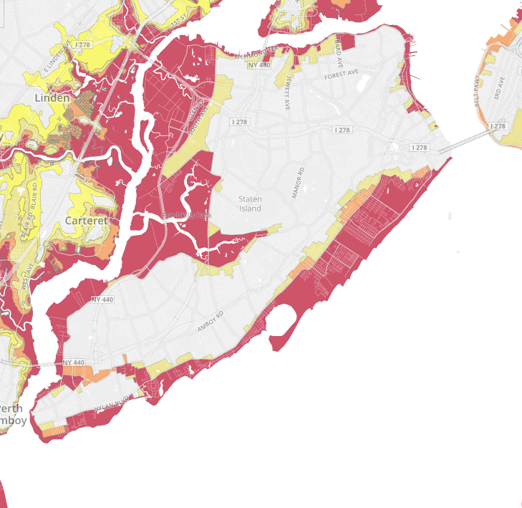
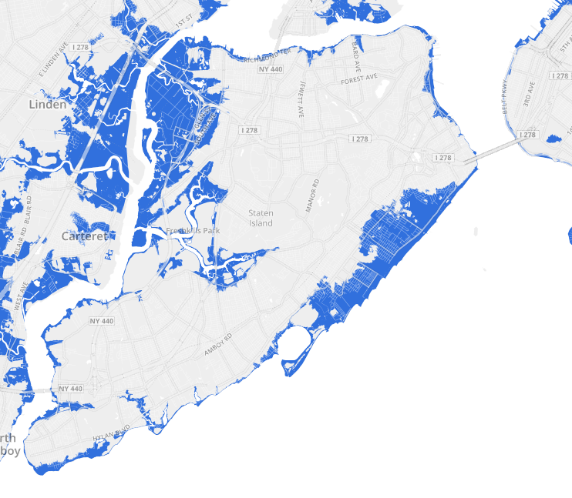
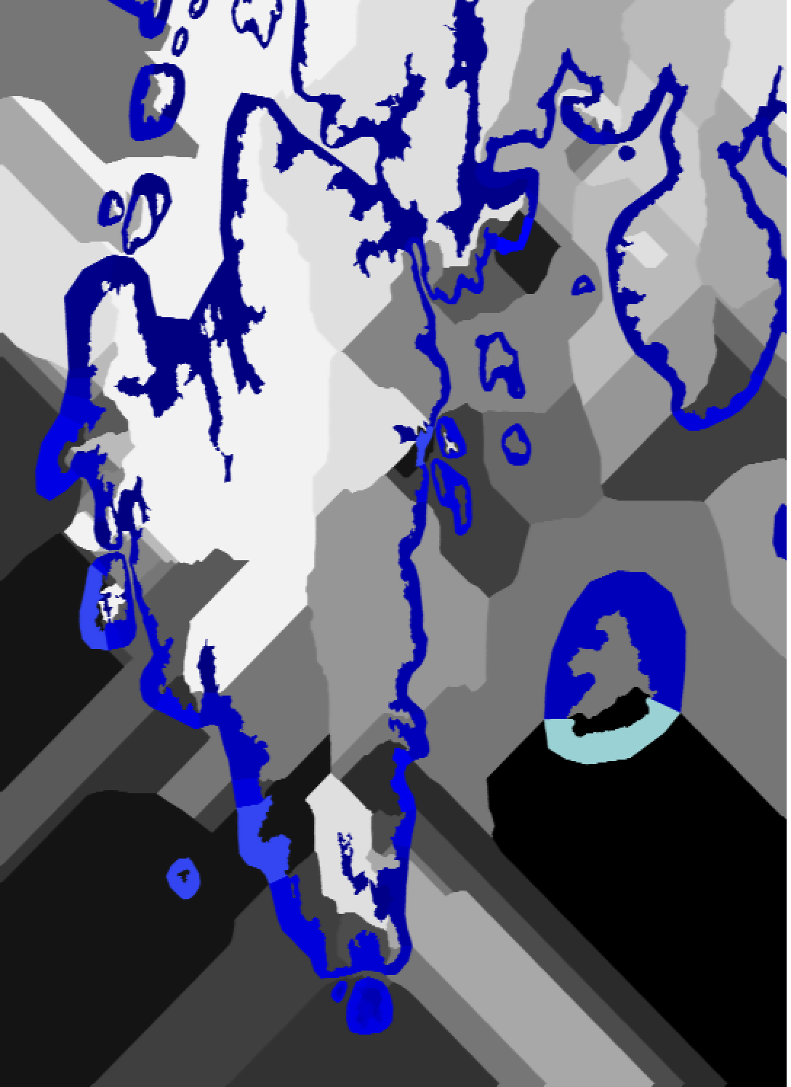
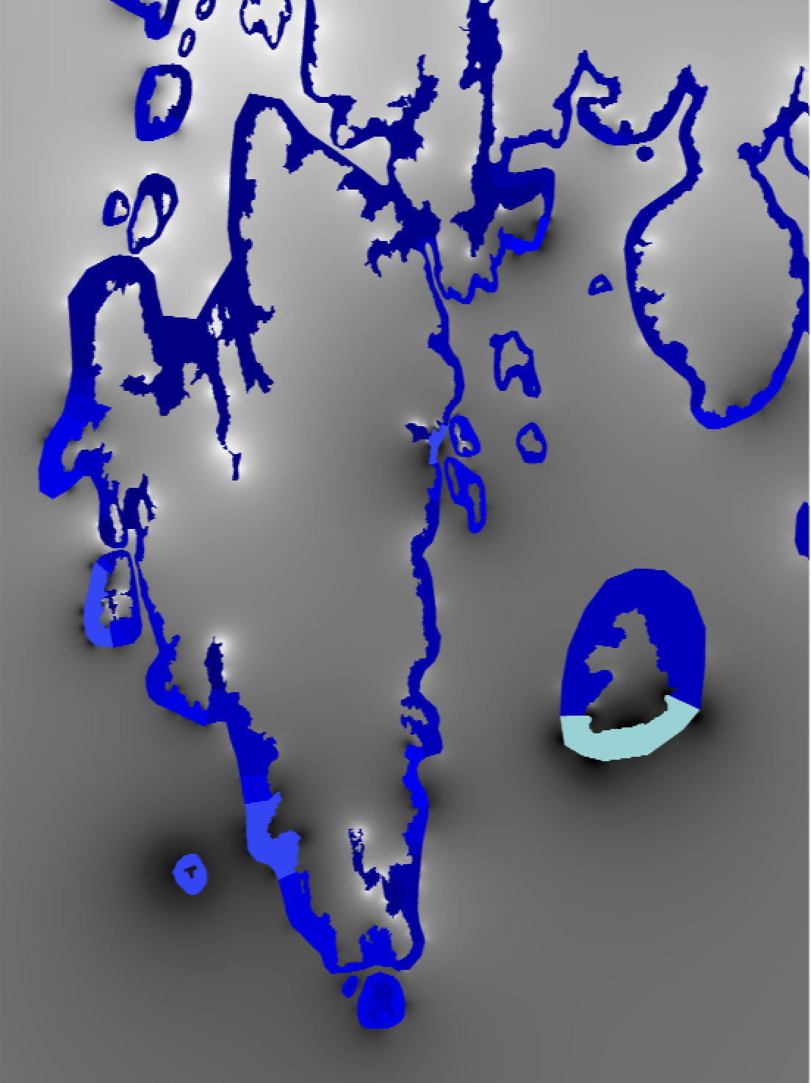
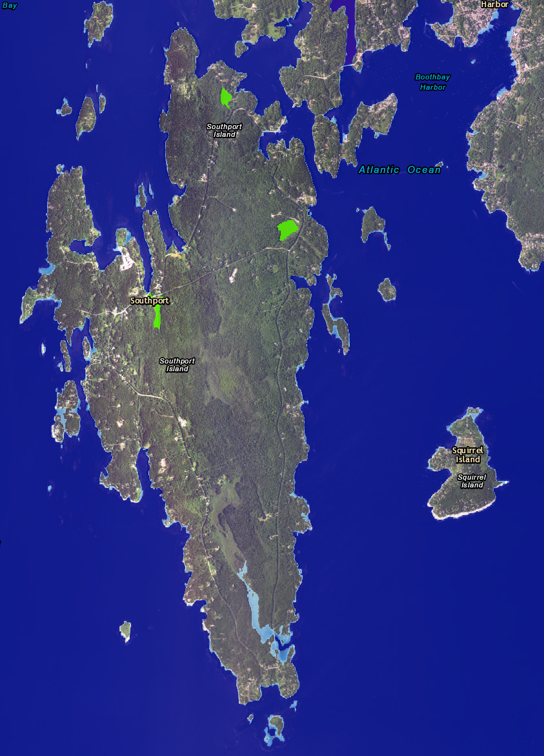
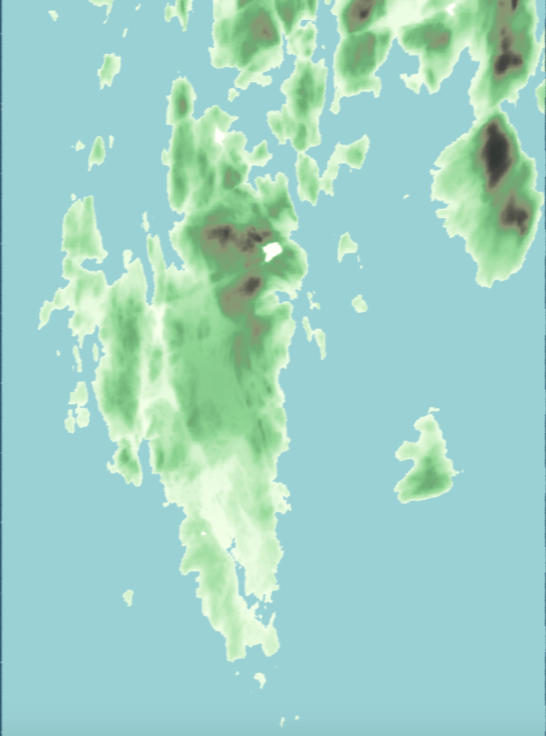
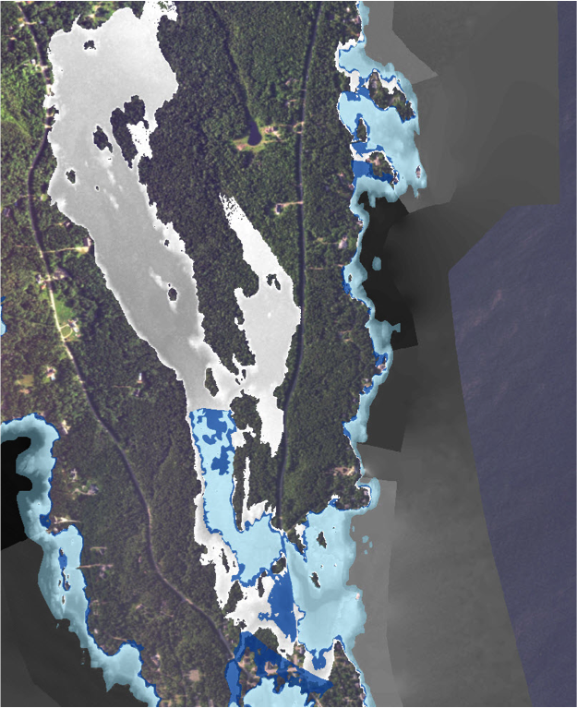
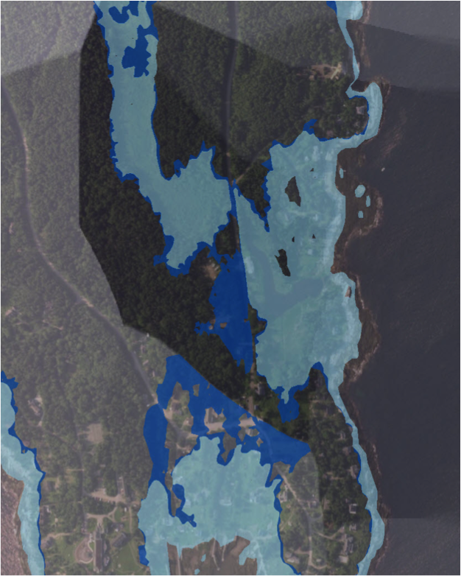
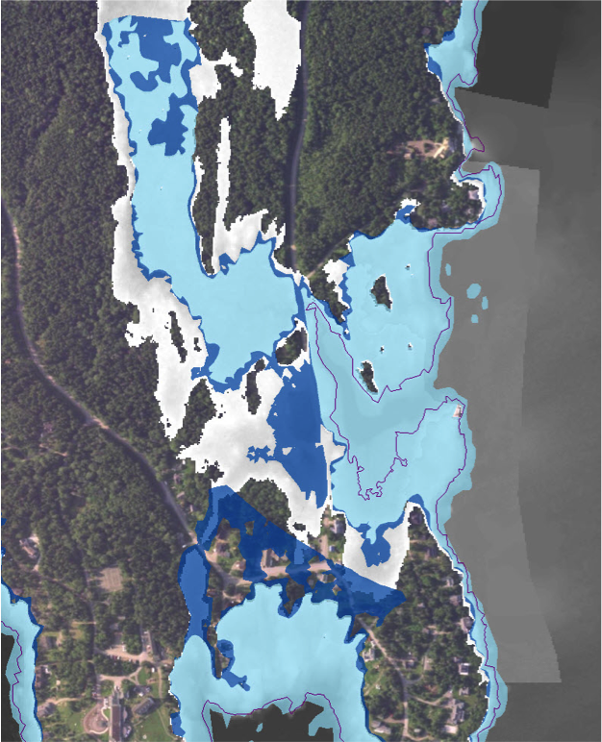
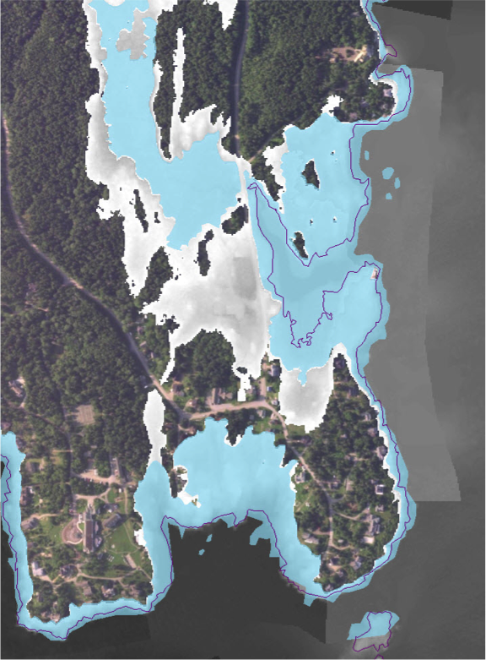
Efficient Computations of Flooding Scenarios for the Coast of Maine
Corinne Alini
Faculty Advisors: Laura Toma, Eileen Johnson
Department of Computer Science and Department of Environmental Studies, Bowdoin College, Brunswick ME
Introduction
In 2012, Hurricane Sandy wrought loss of life and damage in the billions of dollars to the Eastern seaboard. NY, like any state, had well-established hundred-year base flood elevation maps (BFE maps). These maps are based on historical data and delineate the areas with 1% likelihood to be flooded by storms. They are good predictors assuming that future storms are similar to past storms. With rising sea-level, this assumption is not true. These maps did not accurately predict Sandy’s storm surge.
With the sea-level predicted to rise as much as 6.6 ft by 2100, storms will bring the flooding further inland. Accurate prediction of storm flooding in the future must combine historical BFEs with rising sea levels produced by global warming.
Methods: Flooding
A point is flooded if:
Its elevation is below the elevation of the ocean, and
It can be reached by the ocean (via a path of flooded points)
Algorithm Idea: To model the combined effect of sea-level rise and storm surges, we simulate inundation coming from the coast. For each point on the coast, determine if point is flooded. If positive, mark it, check surrounding points, and repeat.
Methods: Interpolation
Figure 8: Southport with 3ft SLR on top of BFE (blue). ArcGIS results (red) and our results (white)
To simulate inundation we need to interpolate the values of the BFE map inland, to points that are outside the present flood areas but will be flooded in the future. An IDW (inverse distance weighting) interpolation is computationally-intensive and not a good model for interpolating polygonal data. We describe a new approach for interpolating the BFE map which retains the continuity properties of IDW but is more efficient. We compare it with a nearest-neighbor (NN) interpolation, and with the 5-nearest neighbor interpolation employed by ArcGIS to approximate IDW.
Conclusion
Simple: Two-step process (interpolate, flood), much simpler to use than ArcGIS.
Free and open source (https://github.com/coryalini/slr-bfe-research)
Efficient: e.g. can flood Lincoln county, 2m DEM from LiDAR data, 900 million points in under 3 minutes compared to days in ArcGIS.
Versatile: can model arbitrary sea-level rise, and can combine sea-level rise with BFE and tidal surfaces.
Currently assumes BFE and elevation grid are given in NAVD88 datum. Can be extended to incorporate any tidal surface (e.g. can compute flooding due to MHHW and sea-level rise)
Figure 1: Actual
Figure 2: Predicted
Figure 3: BFE (blue); BFE interpolation using NN ( grayscale)
Figure 4: BFE (blue); BFE interpolation using IDW (grayscale)
Results
Previous Work
Since the devastation of Hurricane Sandy, NOAA has developed a protocol that allows flood scenario models to account for rising sea levels. Some issues with the protocol:
Designed to be implemented in ArcGIS, which does not have a designated flood function so the protocol models flooding via a (long) sequence of steps
The process is tedious and involves some manual parts (identification of connected components)
The process is very slow on large data, taking many hours to complete
Location: Southport Island in Lincoln County, Maine
Data: 2m DEM derived from LiDAR data.
Scenario: Showing 1ft, 3ft and 6ft of sea-level rise on top of the BFE map. Comparing with the results obtained with ArcGIS shows overall similarity, with some differences which we attribute to the interpolation used by ArcGIS - see below how the flood map is cut due to the jump in BFE values.
Future Work
Future work includes:
Further testing and validation of the results compared to previous results in ArcGIS and other related work
Efficiency: Adding parallelization to further decrease running time
Expanding simulations to include all of coastal Maine
Figure 5: 6 ft sea-level rise, in ArcGIS
Figure 6: 6 ft sea-level rise, our results
Goals
This research aims to provide a simple, efficient and accurate approach for the computation of flooding scenarios based on NOAA’s protocol. We provide a unified framework for computing flooding due to sea-level rise in combination with BFE and any other datum surface.
References
Keefe, John, Steven Melendez, and Louise Ma. "Flooding and Flood Zones | WNYC." Project.wnyc.org. November 10, 2012. https://project.wnyc.org/flooding-sandy-new/#12.00/40.7378/-74.0702.
"Detailed Method for Mapping Sea Level Rise Inundation." Coast.noaa.gov. January 2017. https://coast.noaa.gov/data/digitalcoast/pdf/slr-inundation-methods.pdf.
Lindsey, Rebecca. "Climate Change: Global Sea Level." Climate.gov. September 11, 2017. https://www.climate.gov/news-features/understanding-climate/climate-change-global-sea-level.
DEM
(digital elevation model)
open-source, efficient flood model
Existing Flood zones (BFE)
Flooded grid
Rise (xx ft)
Figure 7: Southport, close up. Flooding with 1ft sea-level rise on top of the BFE map.
BFE map in light blue, results with ArcGIS in dark blue, our results in white.
Acknowledgements: Special thanks to Professor of Computer Science Laura Toma, Professor of Environmental Studies Eileen Johnson, and the Rusack Coastal Studies Fellowship for their support.

